Slide 1
Course Code: 20CS401 Course Title: Database Management Systems Academic Year: 2024 - 2025 (Even Sem)
Syllabus 23IT201- DATABASE MANAGEMENT SYSTEMS
Theory

Slide 2
Module 2 23IT201- DATABASE MANAGEMENT SYSTEMS
MODULE 3 TRANSACTIONS AND ADVANCED CONCEPTS
Transaction Concepts - Transaction model - ACID Properties -
Theory

Slide 3

Module 2 23IT201- DATABASE MANAGEMENT SYSTEMS
Transaction Concept
A transaction is a unit of program execution that accesses and possibly updates various data items
For example, transaction to transfer $50 from account A to account B:
1. read(A)
2. A := A – 50
3. write(A)
4. read(B)
5. B := B + 50
6. write(B)
Two main issues to deal with:
Failures of various kinds, such as hardware failures and system crashes
Concurrent execution of multiple transactions
Theory

Slide 4
Module 2 23IT201- DATABASE MANAGEMENT SYSTEMS
Required Properties of a Transaction
Atomicity requirement
If the transaction fails after step 3 and before step 6, money will be “lost” leading to an inconsistent database state
Failure could be due to software or hardware
The system should ensure that updates of a partially executed transaction are not reflected in the database
Transaction to transfer $50 from account A to account B:
1. read(A)
2. A := A – 50
3. write(A)
4. read(B)
5. B := B + 50
6. write(B)
Theory

Slide 5
Module 2 23IT201- DATABASE MANAGEMENT SYSTEMS
Required Properties of a Transaction
Consistency requirement
In example, the sum of A and B is unchanged by the execution of the transaction . In general, consistency requirements include
Explicitly specified integrity constraints
– primary keys and foreign keys
Implicit integrity constraints
– sum of balances of all accounts, minus sum of loan amounts must equal value of cash-in-hand
A transaction, when starting to execute, must see a consistent database
During transaction execution the database may be temporarily inconsistent
When the transaction completes successfully the database must be consistent
Erroneous transaction logic can lead to inconsistency
1. read(A)
2. A := A – 50
3. write(A)
4. read(B)
5. B := B + 50
6. write(B)
Theory

Slide 6
Module 2 23IT201- DATABASE MANAGEMENT SYSTEMS
Required Properties of a Transaction
Isolation requirement
If between steps 3 and 6 (of the fund transfer transaction) , another transaction T2 is allowed to access
the partially updated database, it will see an inconsistent database (the sum A + B will be less than it
should be).
T1 T2
1. read(A)
2. A := A – 50
3. write(A)
read(A), read(B), print(A+B)
4. read(B)
5. B := B + 50
6. write(B
Isolation can be ensured trivially by running transactions serially
That is, one after the other
However, executing multiple transactions concurrently has significant benefits
Theory

Slide 7
Module 2 23IT201- DATABASE MANAGEMENT SYSTEMS
Required Properties of a Transaction
Durability requirement
Once the user has been notified that the transaction has completed (i.e., the transfer of the $50 has taken
place), the updates to the database by the transaction must persist even if there are software or hardware
failures
Transaction to transfer $50 from account A to account B:
1. read(A)
2. A := A – 50
3. write(A)
4. read(B)
5. B := B + 50
6. write(B)
Theory

Slide 8
Module 2 23IT201- DATABASE MANAGEMENT SYSTEMS
ACID Properties
A transaction is a unit of program execution that accesses and possibly updates various data items. To preserve the integrity of data the database system must ensure:
Atomicity:
Either all operations of the transaction are properly reflected in the database or none are
Consistency:
Execution of a transaction in isolation preserves the consistency of the database
Isolation:
Although multiple transactions may execute concurrently, each transaction must be unaware of other concurrently executing transactions. Intermediate transaction results must be hidden from other concurrently executed transactions . That is, for every pair of transactions Ti and Tj , it appears to Ti that either Tj , finished execution before Ti started, or Tj started execution after Ti finished
Durability:
After a transaction completes successfully, the changes it has made to the database persist, even if there are system failures
Theory

Slide 9
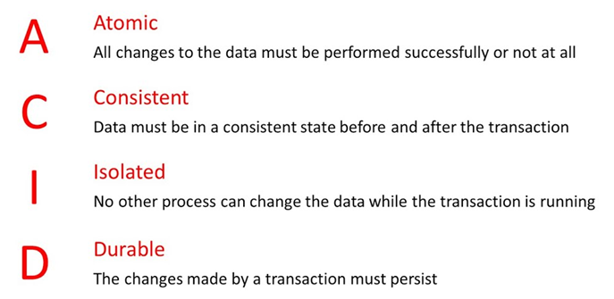
Module 2 23IT201- DATABASE MANAGEMENT SYSTEMS
ACID Properties
Theory

Slide 10
Module 2 23IT201- DATABASE MANAGEMENT SYSTEMS
TRANSACTION STATE
Active, the initial state; the transaction stays in this state while it is executing
Partially committed, after the final statement has been executed.
Failed, after the discovery that normal execution can no longer proceed.
Aborted, after the transaction has been rolled back and the database restored to its state prior to the start of the transaction.
Two options after it has been aborted:
🟊 restart the transaction – only if no internal logical error
🟊 kill the transaction
Committed, after successful completion.
Theory

Slide 11
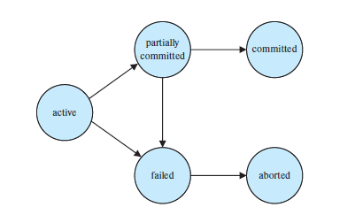
Module 2 23IT201- DATABASE MANAGEMENT SYSTEMS
TRANSACTION STATE
Theory

Slide 12
Module 2 23IT201- DATABASE MANAGEMENT SYSTEMS
Concurrent Executions
Multiple transactions are allowed to run concurrently in the system. Advantages are:
Increased processor and disk utilization, leading to better transaction throughput E.g. one transaction can be using the CPU while another is reading from or writing to the disk
Reduced average response time for transactions: short transactions need not wait behind long ones.
Concurrency control schemes – mechanisms to achieve isolation
Prevent them from destroying the consistency of the database
Theory

Slide 13
Module 2 23IT201- DATABASE MANAGEMENT SYSTEMS
Concurrent Executions
Schedule – a sequences of instructions that specify the chronological order in which instructions of concurrent transactions are executed
A schedule for a set of transactions must consist of all instructions of those transactions
Must preserve the order in which the instructions appear in each individual transaction.
A transaction that successfully completes its execution will have a commit instructions as the last statement
By default transaction assumed to execute commit instruction as its last step
A transaction that fails to successfully complete its execution will have an abort instruction as the last statement
Theory

Slide 14
Module 2 23IT201- DATABASE MANAGEMENT SYSTEMS
Concurrent Executions
T1: read(A);
A := A − 50;
write(A);
read(B);
B := B + 50;
write(B).
T2: read(A);
temp := A * 0.1;
A := A − temp;
write(A);
read(B);
B := B + temp;
write(B).
Transaction T1 transfers $50 from account A to account B.
Transaction T2 transfers 10 percent of the balance from account A to account B
Theory

Slide 15
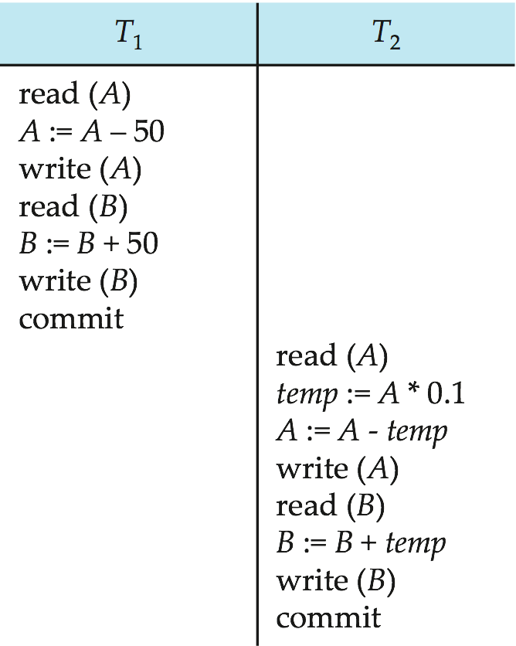
Module 2 23IT201- DATABASE MANAGEMENT SYSTEMS
Schedule 1
Let T₁ transfer $50 from A to B, and T₂ transfer 10% of the balance from A to B. An example of a serial schedule in which T₁ is followed by T₂ :
Theory

Slide 16
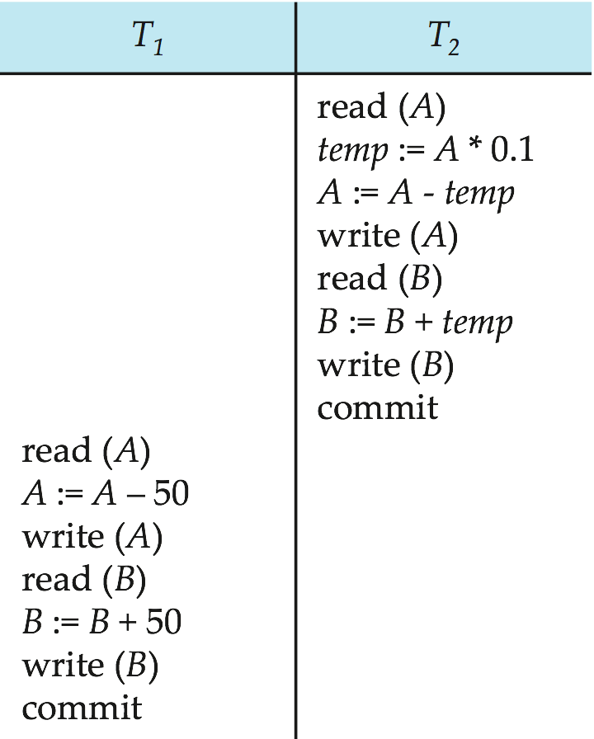
Module 2 23IT201- DATABASE MANAGEMENT SYSTEMS
Schedule 2
A serial schedule in which T₂ is followed by T₁ :
When the database system executes several transactions concurrently, the corresponding schedule no longer needs to be serial.
If two transactions are running concurrently, the operating system may execute one transaction for a little while, then perform a context switch, execute the second transaction for some time, and then switch back to the first transaction for some time, and so on.
With multiple transactions, the CPU time is shared among all the transactions
Theory

Slide 17
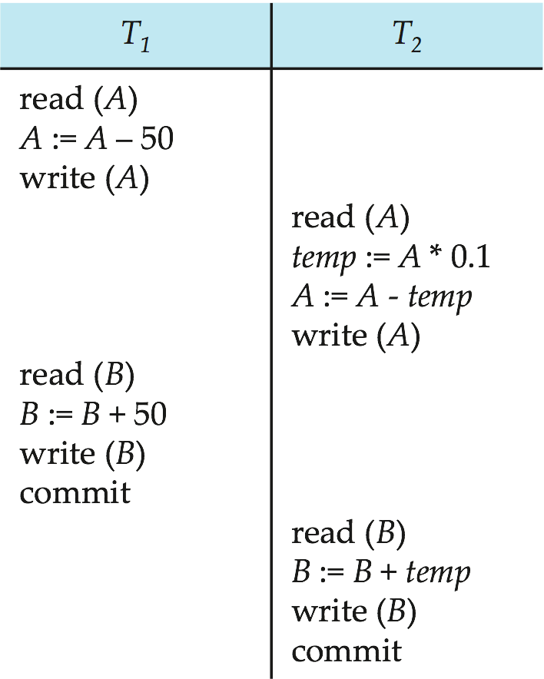
Schedule 3
Module 2 23IT201- DATABASE MANAGEMENT SYSTEMS
Let T₁ and T₂ be the transactions defined previously. The following schedule is not a serial schedule, but it is equivalent to Schedule 1.
After this execution takes place, we arrive at the same state as the one in which the transactions are executed serially in the order T1 followed by T2.
The sum A + B is indeed preserved.
Schedule 1
Schedule 3

Slide 18
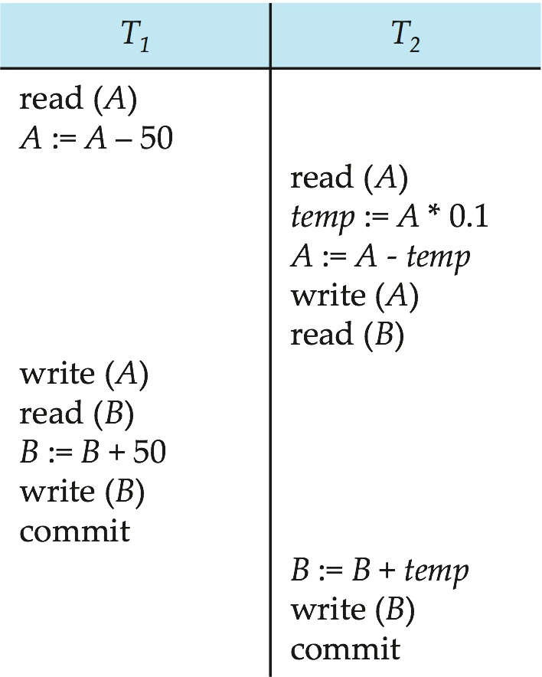
Schedule 4
Module 2 23IT201- DATABASE MANAGEMENT SYSTEMS
After the execution of this schedule, we arrive at a state where the final values of accounts A and B are $950 and $2100, respectively.
This final state is an inconsistent state, since we have gained $50 in the process of the concurrent execution.
Indeed, the sum A + B is not preserved by the execution of the two transactions.
The following concurrent schedule does not preserve the sum of “A + B”
Schedule 1
Schedule 4

